Slide 1

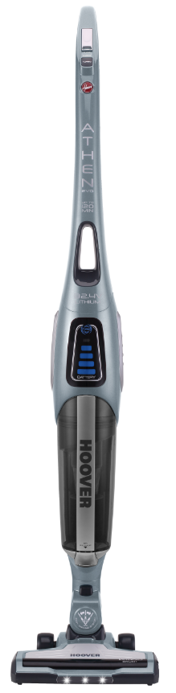


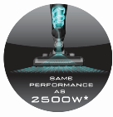
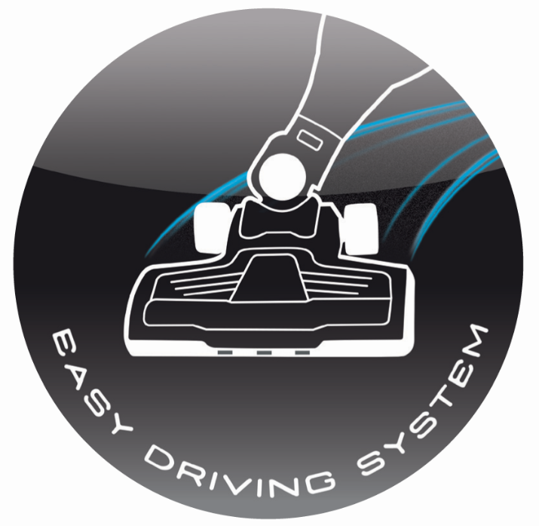
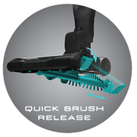
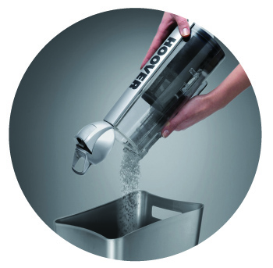

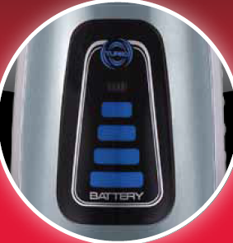
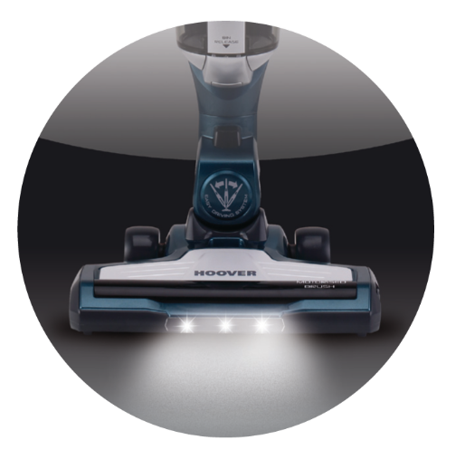

ATHEN EVO
DRIVE THE POWER
ATV324LD 011
LITHIUM ION
DIAMOND BLUE
Cordless 32.4V Lithium Ion
Autonomy: up to 120 min
Fast charge in 4 hours
Cyclean bagless technology
LED Display:
  - Battery Level
  - Turbo Icon
  - Charge Indication
All Surfaces Cleaning:
  - Floor Mode
  - Carpet Mode
  - Turbo Mode
Vertical Parking Position (stand alone)
EASY DRIVING SYSTEM: SWIVEL NECK
EASY ACCESS TO BRUSH BAR
NOZZLE FRONTAL LED LIGHTS
Washable EPA filter
Easy bin empty
Soft wheels
Carry handle
Bin capacity: 1,0 l
Charger cord lenght: 1,5 m
CODES
PRODUCT CODE | 39400269
EAN CODE | 8016361923546
DIMENSIONS AND WEIGHT
PRODUCT DIMENSION ( L*W*H ) mm | 250*220*1220
PACK DIMENSIONS ( L*W*H ) mm | 230x225x635
WEIGHT (NET/GROSS) | 3,3/4,8 Kg
EASY DRIVING SYSTEM
EASY ACCESS TO BRUSH BAR
EASY BIN EMPTY
EFFORTLESS
USE
CYCLEAN TECHNOLOGY
LED
DISPLAY
NOZZLE LED
LIGHTS
ALL SURFACES CLEANING
MAIN FEATURES
32.4V LITHIUM BATTERY
Fast 4 hours charging time, with the convenience of lightweight lithium battery pack
EXTRAORDINARY AUTONOMY UP TO 120 MIN
To clean all your house without limits
MAXIMUM MANOEUVRABILITY
The innovative Easy Driving System has been designed to give you the maximum comfort and flexibility
* Based on internal tests of dust removal, from hard flat floors and from hard floors with crevices, to EN standard EN60312-1, when compared to the Hoover model TAT2520 011.

